Slide 1

Department of Computer Science
University Institute of Engineering
DEPARTMENT OF COMPUTER SCIENCE & ENGINEERING
Bachelor of Engineering
Subject Name: System Programming
Subject Code: CST-315
Compilers
DISCOVER . LEARN . EMPOWER

Slide 2
1. Introduction to Grammars and finite automata

Slide 3
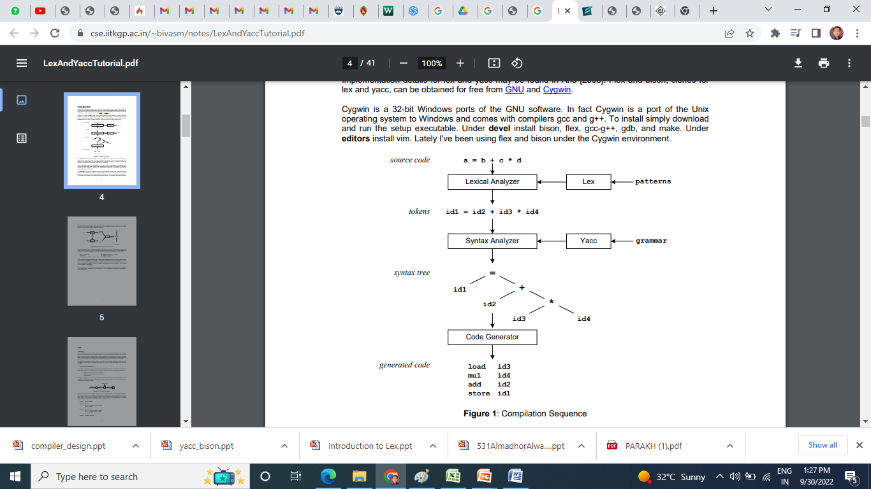
Introduction to Grammars

Slide 4
Introduction to Grammars

Slide 5

Lexical and Pattern & Token :
int max ( x , y)
/* Find maximum of x and y *\
{
Return ( x>y? x :y)
}

Slide 6
Introduction to Grammars
During the first phase the compiler reads the input and converts strings in the source to tokens.
With regular expressions we can specify patterns to lex so it can generate code that will allow it to scan and match strings in the input.
Each pattern specified in the input to lex has an associated action.

Slide 7
Introduction to Grammars
Typically an action returns a token that represents the matched string for subsequent use by the parser.
Initially we will simply print the matched string rather than return a token value.
The following represents a simple pattern, composed of a regular expression, that scans for identifiers.
letter(letter|digit)*
Lex will read this pattern and produce C code for a lexical analyzer that scans for identifiers.

Slide 8
Introduction to Grammars
letter(letter|digit)*
This pattern matches a string of characters that begins with a single letter followed by zero or more letters or digits.
This example nicely illustrates operations allowed in regular expressions:
Repetition, expressed by the “*” operator
Alternation, expressed by the “|” operator
Concatenation

Slide 9
Introduction to Grammars
Any regular expression expressions may be expressed as a finite state automaton (FSA).
We can represent an FSA using states, and transitions between states.
There is one start state and one or more final or accepting states

Slide 10
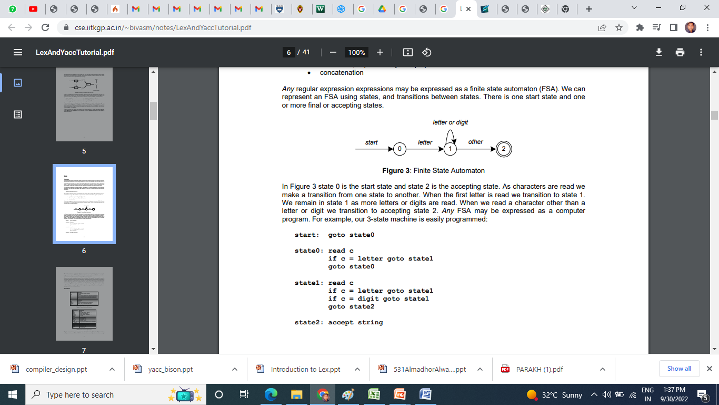
Introduction to Grammars
Any regular expression expressions may be expressed as a finite state automaton (FSA).
We can represent an FSA using states, and transitions between states.
There is one start state and one or more final or accepting states
letter(letter|digit)*
A
A1
AA1
1a

Slide 11
Introduction to Grammars
In Figure 3 state 0 is the start state and state 2 is the accepting state.
As characters are read we make a transition from one state to another. When the first letter is read we transition to state 1. We remain in state 1 as more letters or digits are read.
When we read a character other than a letter or digit we transition to accepting state 2. Any FSA may be expressed as a computer program. For example, our 3-state machine is easily programmed:

Slide 12
Introduction to Grammars

Slide 13
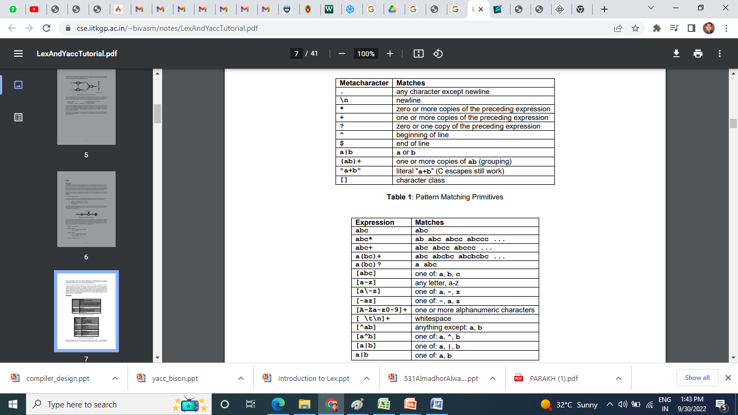
Introduction to Grammars

Slide 14
Introduction to Grammars

Slide 15
Introduction to Grammars
CFG – Context Free Grammars
A Grammar is a 4-tuple such that-
CFG or G = (V , T , P , S)
where-
V = Finite non-empty set of non-terminal symbols
T = Finite set of terminal symbols
P = Finite non-empty set of production rules
S = Start symbol

Slide 16
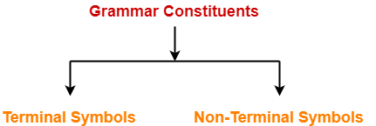
CFG – Context Free Diagram
Grammar Constituents-
Grammar is mainly composed of two basic elements-

Slide 17
CFG – Context Free Diagram
1. Terminal Symbols - Terminal symbols are those which are the constituents of the sentence generated using grammar.
Terminal symbols are denoted by using small case letters such as a, b, c etc.
2. Non-Terminal Symbols - Non-Terminal symbols are those which take part in the generation of the sentence but are not part of it.
Non-Terminal symbols are also called auxiliary symbols or variables.
Non-Terminal symbols are denoted by using capital letters such as A, B, C etc.

Slide 18
CFG – Context Free Diagram
3. P → Production Rule
α→β
α→V ( Non Terminal Symbol)
β → (V ∪ T)
β → (Non Terminal Symbol ∪ Terminal Symbol)

Slide 19
CFG – Context Free Diagram
4. Start Symbol → S
α→β
β → (V ∪ T)
S→ E
(Start Symbol) → (Expression)
Production Rule E→ E+E / E*E / id
Input String W = id + id * id

Slide 20
CFG – Context Free Diagram
4. Start Symbol → S
S→ E
Production Rule E→ E+E / E*E / id
Input String W = id+id*id
E→ E+E / E*E / id
E→ E+E
E→ E*E
E → id

Slide 21
CFG – Context Free Diagram
Two Types of Derivatives
Left Most
Right Most

Slide 22
CFG – Context Free Diagram
Left Most Derivatives
Input String W = id+id*id
E→ E + E

Slide 23
CFG – Context Free Diagram
Left Most
Input String W = id+id*id
E→ E + E
E→ id + E

Slide 24
CFG – Context Free Diagram
Left Most
Input String W = id+id*id
E→ E + E
E→ id + E * E

Slide 25
CFG – Context Free Diagram
Left Most
Input String W = id+id*id
E→ E + E
E→ id + E * E
E→ id + id * E

Slide 26
CFG – Context Free Diagram
Left Most
Input String W = id+id*id
E→ E + E
E→ id + E * E
E→ id + id * E
E→ id + id * id

Slide 27
CFG – Context Free Diagram
Left Most
Input String W = id+id*id
E→ E + E
E→ id + E * E
E→ id + id * E
E→ id + id * id
Right Most
Input String W = id+id*id
E→ E + E

Slide 28
CFG – Context Free Diagram
Left Most
Input String W = id+id*id
E→ E + E
E→ id + E * E
E→ id + id * E
E→ id + id * id
Right Most Derivatives

Slide 29
CFG – Context Free Diagram
Left Most
Input String W = id+id*id
E→ E + E
E→ id + E * E
E→ id + id * E
E→ id + id * id
Right Most
Input String W = id+id*id
E→ E + E

Slide 30
CFG – Context Free Diagram
Left Most
Input String W = id+id*id
E→ E + E
E→ id + E * E
E→ id + id * E
E→ id + id * id
Right Most
Input String W = id+id*id
E→ E + E * E

Slide 31
CFG – Context Free Diagram
Left Most
Input String W = id+id*id
E→ E + E
E→ id + E * E
E→ id + id * E
E→ id + id * id
Right Most
Input String W = id+id*id
E→ E + E
E→ E + E * E

Slide 32
CFG – Context Free Diagram
Left Most
Input String W = id+id*id
E→ E + E
E→ id + E * E
E→ id + id * E
E→ id + id * id
Right Most
Input String W = id+id*id
E→ E + E
E→ E + E * E
E→ E + E * id

Slide 33
CFG – Context Free Diagram
Left Most
Input String W = id+id*id
E→ E + E
E→ id + E * E
E→ id + id * E
E→ id + id * id
Right Most
Input String W = id+id*id
E→ E + E
E→ E + E * E
E→ E + E * id
E→ E + id * id

Slide 34
CFG – Context Free Diagram
Left Most
Input String W = id+id*id
E→ E + E
E→ id + E * E
E→ id + id * E
E→ id + id * id
Right Most
Input String W = id+id*id
E→ E + E
E→ E + E * E
E→ E + E * id
E→ E + id * id
E→ id + id * id

Slide 35
CFG – Context Free Diagram
Left Most
Input String W = id+id*id
E→ E + E
E→ id + E * E
E→ id + id * E
E→ id + id * id
Right Most
Input String W = id+id*id
E→ E + E
E→ E + E * E
E→ E + E * id
E→ E + id * id
E→ id + id * id
E→ E * E
E→ E + E * E
E→ id + E * E
E→ id + id * E
E→ id + id * id

Slide 36
CFG – Context Free Diagram
Right Most
Input String W = id+id*id
E→ E + E
E→ E + E * E
E→ E + E * id
E→ E + id * id
E→ id + id * id
Left Most
Input String W = id+id*id
E→ E + E
E→ id + E * E
E→ id + id * E
E→ id + id * id
E→ E * E
E→ E * id
E→ E + E * id
E→ E + id * id
E→ id + id * id
E→ E * E
E→ E + E * E
E→ id + E * E
E→ id + id * E
E→ id + id * id

Slide 37
Left Most
Input String W = id+id*id
E→ E + E
E→ id + E * E
E→ id + id * E
E→ id + id * id
Right Most
Input String W = id+id*id
E→ E + E
E→ E + E * E
E→ E + E * id
E→ E + id * id
E→ id + id * id
E

Slide 38
Left Most
Input String W = id+id*id
E→ E + E
E→ id + E * E
E→ id + id * E
E→ id + id * id
Right Most
Input String W = id+id*id
E→ E + E
E→ E + E * E
E→ E + E * id
E→ E + id * id
E→ id + id * id
E
E
+
E
E
*
E
id
id
id

Slide 39
Left Most
Input String W = id+id*id
E→ E + E
E→ id + E * E
E→ id + id * E
E→ id + id * id
Right Most
E→ E * E
E→ E + id
E→ E + E * id
E→ E + id * id
E→ id + id * id
E
E
E
*
E
E
+
E
E
*
E
+
E
id
id
E
id
id
id
id

Slide 40
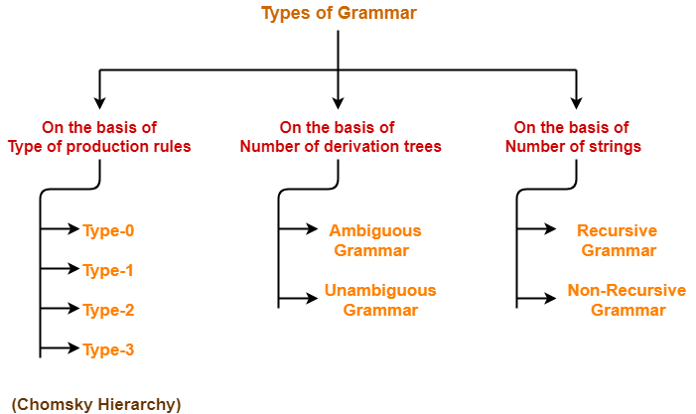
CFG – Context Free Diagram
Types of Grammars-
Grammars are classified on different basis as-

Slide 41
Case study :LEX and YACC
Case study :LEX and YACC
LEX
Lex Lexical Analyser".
Its main job is to break up an input stream into more usable elements.
Or in, in other words, to identify the "interesting bits" in a text file.
For example, if you are writing a compiler for the C programming language, the symbols { } ( ); all have significance on their own.

Slide 42
Case study :LEX and YACC
LEX
The letter a usually appears as part of a keyword or variable name, and is not interesting on its own.
Instead, we are interested in the whole word.
Spaces and newlines are completely uninteresting, and we want to ignore them completely unless they appear within quotes "like this“
All of these things are handled by the Lexical Analyser.

Slide 43
Case study :LEX and YACC
LEX
A tool widely used to specify lexical analyzers for a variety of languages
We refer to the tool as Lex compiler, and to its input specification as the Lex language.

Slide 44
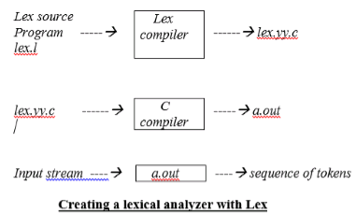
Case study :LEX and YACC

Slide 45
Case study :LEX and YACC
Lex specifications:
A Lex program (the .l file) consists of three parts:
declarations
%%
translation rules
%%
auxiliary procedures
The declarations section includes declarations of variables, and manifest constants (A manifest constant is an identifier that is declared to represent a constant e.g. # define PIE 3.14) and regular definitions.
The translation rules of a Lex program are statements of the form :
p1 {action 1}
p2 {action 2}
p3 {action 3}
… …
… …
Where each p is a regular expression and each action is a program fragment describing what action the lexical analyser should take when a pattern p matches a lexeme. In Lex, the actions are written in C.
The third section holds whatever auxiliary procedures are needed by the actions. Alternatively, these procedures can be compiled separately and loaded with the lexical analyzer.

Slide 46
Case study :LEX and YACC
YACC
Yacc is officially known as a "parser".
It's job is to analyze the structure of the input stream, and operate on the "big picture".
In the course of its normal work, the parser also verifies that the input is syntactically sound.
Consider again the example of a C-compiler.
In the C-language, a word can be a function name or a variable, depending on whether it is followed by a (or a =
There should be exactly one } for each { in the program.
YACC stands for "Yet another Compiler Compiler".
This is because this kind of analysis of text files is normally associated with writing compilers.

Slide 47
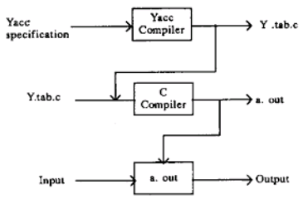
Case study :LEX and YACC

Slide 48
Case study :LEX and YACC
Difference between LEX and YACC
Lex is used to splitting the text into a list of tokens, text becomes a token can be specified using regular expression in the lex file.
Yacc is used to give some structure to those tokens. For example in Programming languages, we have assignment statements like int a = 1 + 2; and i want to make sure that the left-hand side of '=' be an identifier and the right side be an expression [it could be more complex than this].
This can be coded using a CFG rule and this is what you specify in yacc file and this you cannot do using lex (Lex cannot handle recursive languages).
A typical application of lex and yacc is for implementing programming languages.
Lex tokenizes the input, breaking it up into keywords, constants, punctuation, etc.
Yacc then implements the actual computer language; recognizing a for statement, for instance, or a function definition.
Lex and yacc are normally used together. This is how you usually construct an application using both:
Input Stream (characters) -> Lex (tokens) ->Yacc (Abstract Syntax Tree) -> Your Application

Slide 49
Left Most
Input String W = id+id*id
E→ E + E
E→ id + E * E
E→ id + id * E
E→ id + id * id
Right Most
E→ E * E
E→ E + id
E→ E + E * id
E→ E + id * id
E→ id + id * id
2 + 3* 4
E
E
E
*
E
E
+
E
E
*
E
+
E
id
id
E
id
id
id
id

Slide 50
1.Ho to Check Whether a grammar is ambiguous or not

Slide 51
1.Ho to Check Whether a grammar is ambiguous or not
There is no Algorithm

Slide 52
1.Ho to Check Whether a grammar is ambiguous or not
There is no Algorithm
2.Can one Parser tree may be changed into another

Slide 53
1.Ho to Check Whether a grammar is ambiguous or not
There is no Algorithm
2.Can one Parser tree may be changed into another
There is no Algorithm

Slide 54
1.Ho to Check Whether a grammar is ambiguous or not
There is no Algorithm
2.Can one Parser tree may be changed into another
There is no Algorithm
Solution → Practice

Slide 55
1.Ho to Check Whether a grammar is ambiguous or not
There is no Algorithm
2.Can one Parser tree may be changed into another
There is no Algorithm
Solution

Slide 56
1.Ho to Check Whether a grammar is ambiguous or not
There is no Algorithm
2.Can one Parser tree may be changed into another
There is no Algorithm
Solution → Practice

Slide 57
S → as/sa/a
W - aa

Slide 58
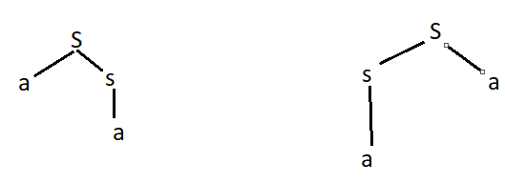
S → as/sa/a
W – aa

Slide 59
S → as/sa/a
W – aa
aa

Slide 60
S → aS/Sa/a
W – aa
aa aa

Slide 61
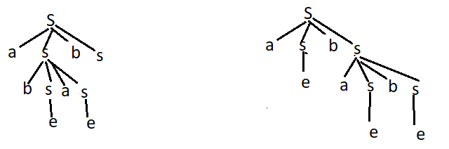
S → aSbS/bSaS/;
W = abab

Slide 62
S → asbs/bsas/;
W = abab
abab

Slide 63
S → asbs/bsas/;
W = abab
abab abab

Slide 64
R → r +r / r*r/ r/ a/b/c
W = a+bc

Slide 65

R → R +R / R*R/ R/ a/b/c
W = a+bc

Slide 66
R → r +r / r*r/ r/ a/b/c
W = a+bc
a+(bc)

Slide 67
R → r +r / r*r/ r/ a/b/c
W = a+bc
a+(bc) (a+b)c

Slide 68
R → r +r / r*r/ r/ a/b/c
W = a+bc 5 +4 * 10 =45
a+(bc) = 5+(4*10)= 45 (a+b)c = (5+4)*10=90

